Slide 1
Docker & Kubernetes
Course Intro, Ynon Perek

Slide 2

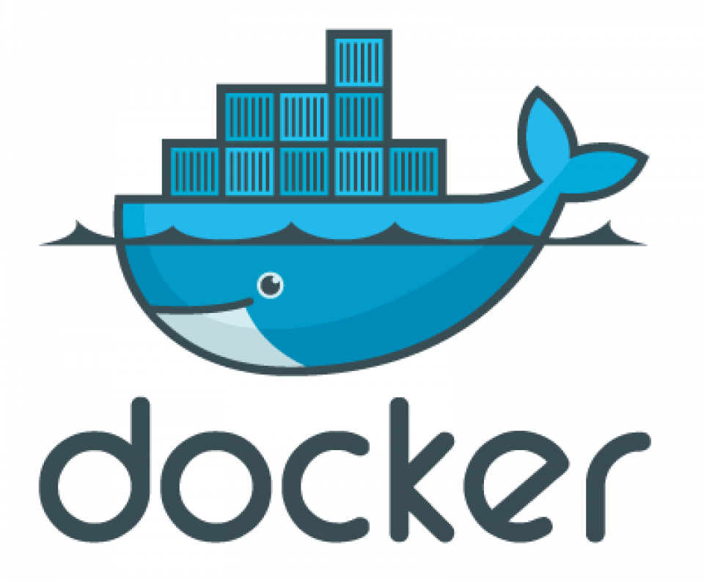
About Docker
Started in 2013
dotCloud
Goal: Shipping

Slide 3
About Me
Ynon Perek
Building dockerized environments
Helping developers use docker better

Slide 4
Who’s It For?
Developers
Already know how to build a monolith
Know Node.JS and some Unix

Slide 5
What’s Inside
Docker
Docker Compose
Building Docker Images
Kubernetes

Slide 6

Ready? Here We Go

